Slide 1


June 4th, 2024
1:00pm – 4:00pm
Oregon Conservation and Recreation Fund
Advisory Committee Meeting
Hybrid Meeting

Slide 2
Agenda Item 1:
Review and Approve Meeting Minutes
(May 7th 2024)

Slide 3
Draft Motion Templates re: Minutes
I move to approve the May 7th, 2024 meeting minutes with the continued authority to correct spelling, grammar, and punctuation.
I move to approve the May 7th, 2024 meeting minutes with the addition/correction/ deletion of ____ on page ___, line ____, and continued authority to correct spelling, grammar, and punctuation.

Slide 4
Agenda Item 2:
Round 7 Spring 2024 Project Recommendations
Reva Gillman, OCRF Grant Coordinator

Slide 5
OCRF Program Updates
OCRF Program Announcements
OCRF Communications Strategy
  OCRF Chairs, ODFW staff, and OWF have finalized Communications Planning - Scope of Work
    RFP was released by Oregon Wildlife Foundation last week! Has garnered a lot of interest already, RFP will close on July 24th
OCRF Advisory Committee tour on Wednesday June 5th :
  To join the tour on Wednesday, meet at Whitaker Ponds 7040 NE 47th Ave, Portland, OR 97218 by 10 a.m. Members of the public who join the tour must provide their own lunch and transportation.
Notes:
Conducted outreach, and OCRF representation at the Oregon outdoor recreation programs, trail alliances, Diversifying the pool of applicants that apply to OCRF. Hopefully this helps address the

Slide 6
Spring 2024 Call for Proposals –
Closed April 2nd 2024
84 complete project proposals submitted:
$4,787,639 – Total Requested Funds ($3,941,985 drought)
$56,995 – Average Request
ODFW Staff Technical Review, and
OCRF Advisory Committee Review of projects is complete
OCRF has two funding buckets this round:
  Drought Funding (about $800,000 )
  Non-Drought Funds

Slide 7
Spring 2024 Call for Proposals –
84 proposals

Slide 8
Spring 2024 Call for Proposals –
21 Projects

Slide 9
Spring 2024 Call for Proposals –
84 Projects

Slide 10
Spring 2024 Call for Proposals –
21 Projects

Slide 11
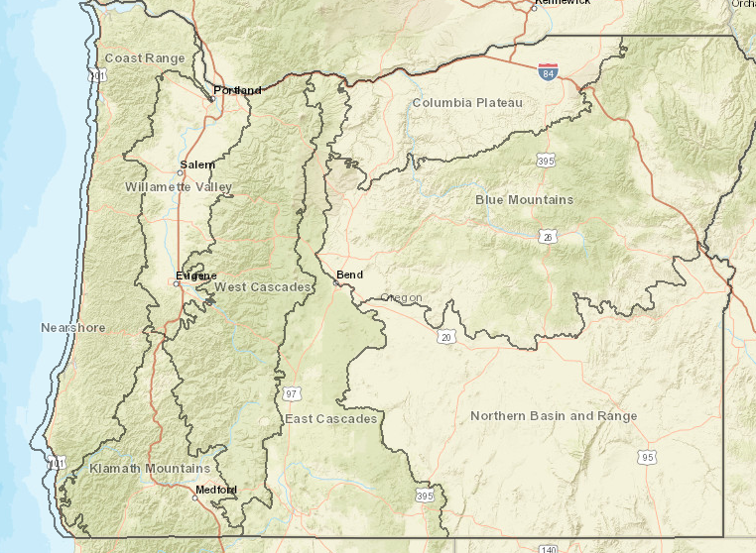
Spring 2024 Call for Proposals –
84 Projects

Slide 12
Spring 2024 Call for Proposals –
21 Projects

Slide 13
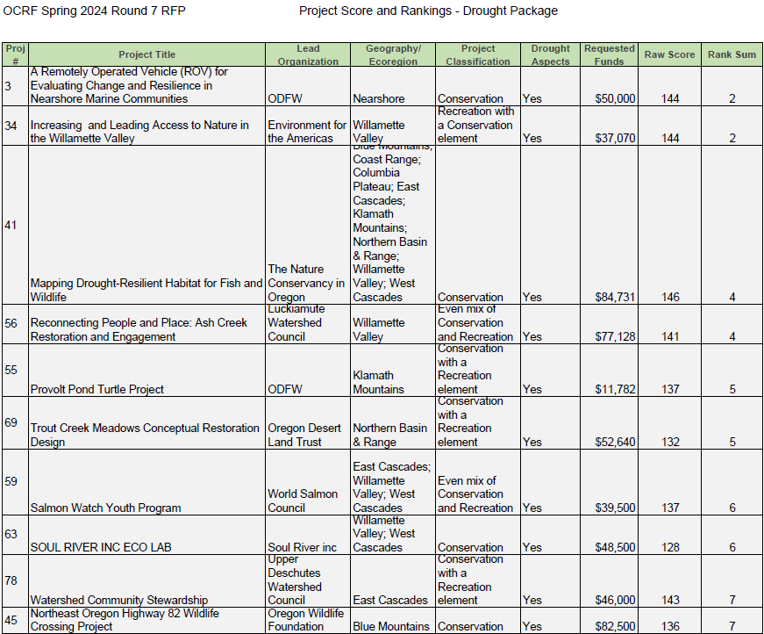
1

Slide 14
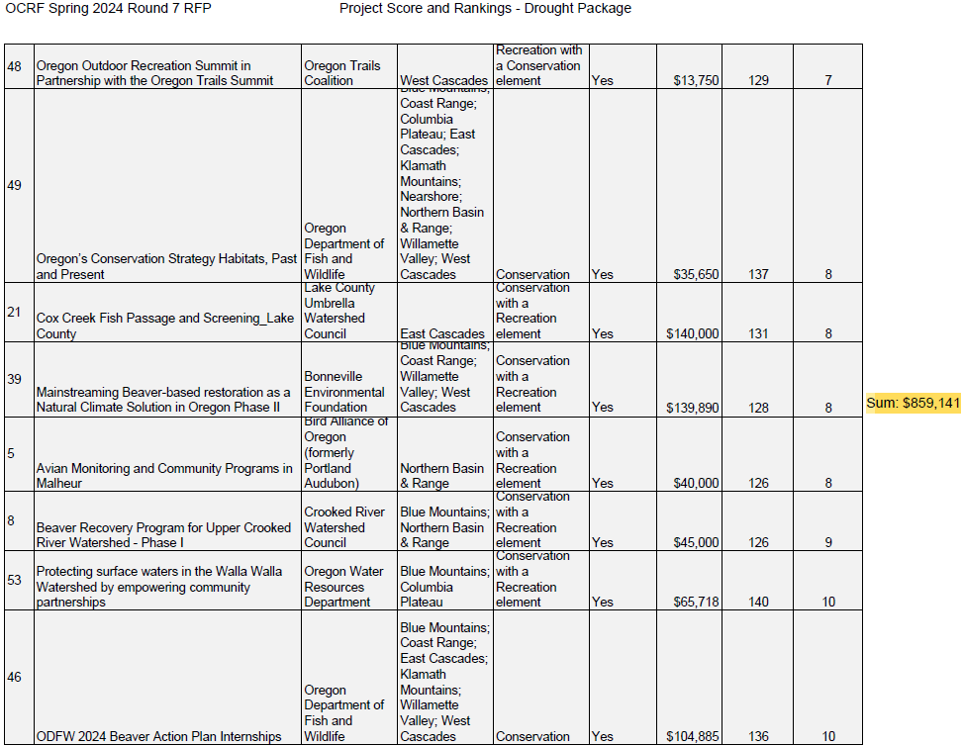
2

Slide 15
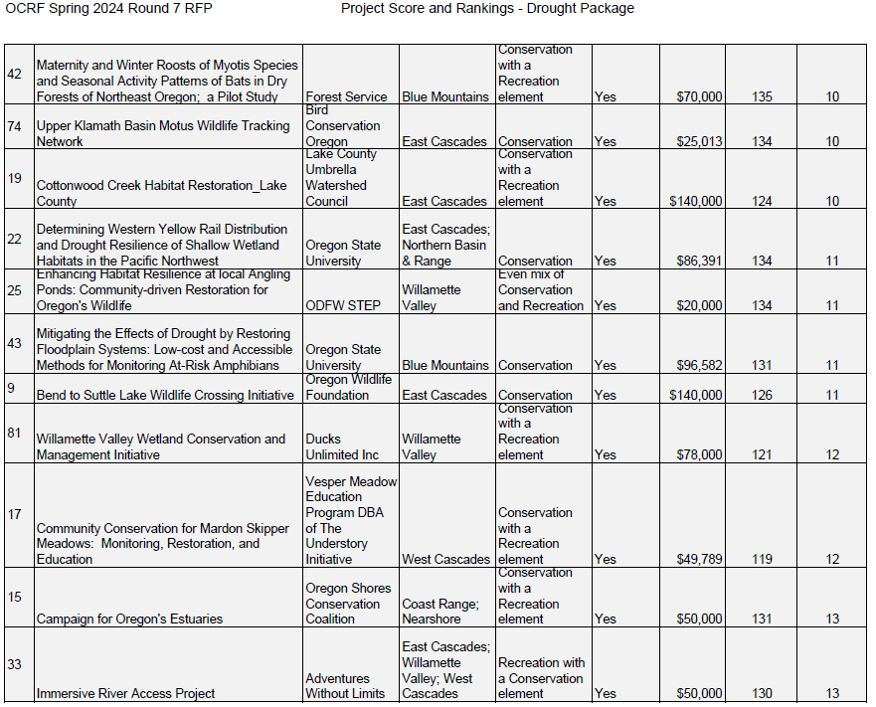

Slide 16
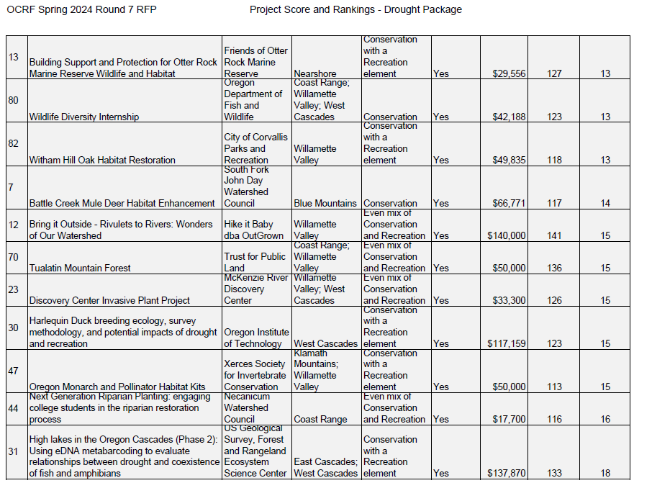

Slide 17
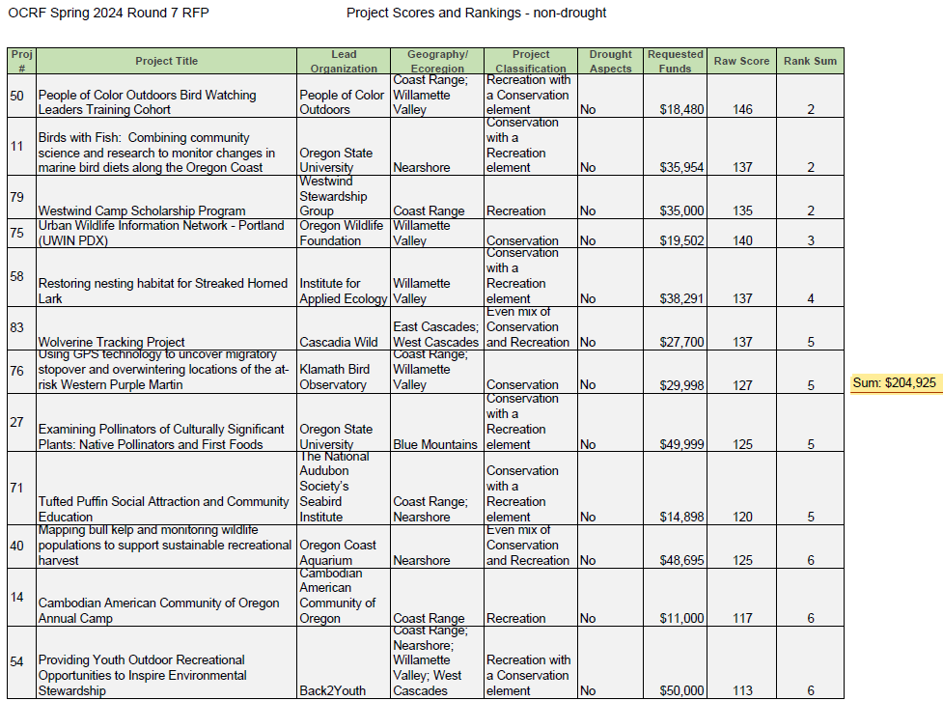

Slide 18
OCRF Budget Update – June ‘24
  Base Program: $1,006,629
    Calculated using (21-23 ending fund balance) + (23-25 revenue to date) – (allocated to projects)
      $892,343 + $1,085,021 – $970,734 = $1,006,629
    Does not include future ELS donations for the remainder of 23-25, or interest that will be deposited in August
  Drought Package: $2,656,815
    (Remaining funds) – (Current Committed Projects + Personnel costs)
  ARPA: $0
    All Federal ARPA funds have been committed to projects
Personnel Costs | 80,000
Current Committed Projects | 1,870,828
Other (held by Oregon Wildlife Foundation): Oregon is Alive ~ $30,000

Slide 19
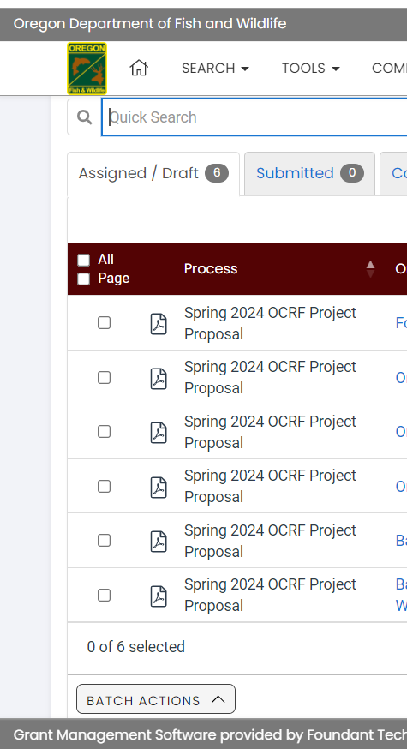
OCRF RFP Update - Spring 2024
Request for Proposals (RFP) – Open January 30th, 2024
Official RFP Guidance made public
Request for Proposals (RFP) – Close March 26th, April 2nd 2024
SUBMITTED: 84
Technical Review Period – April 15 to May 6th, 2024
OCRF Advisory Committee Review Period – April 30th to May 27th , 2024
OCRF Advisory Committee Recommendations – June 4th, 2024 in-person meeting
ODFW Commission Voting – June 14, 2024
Release of funds following contracting process – August/September 2024

Slide 20
Agenda Item 3:
Round 7 Spring 2024: Selection of Recommended Projects

Slide 21
Draft Motion : Selection of Recommended Projects
“I hereby move to approve the top ranked 21 projects from the OCRF Spring 2024 Round 7 RFP, totaling $1,064,066 in expenditure from the Oregon Conservation and Recreation Fund.”
“I hereby move to approve the top ranked __ projects from the OCRF Spring 2024 Round 7 RFP, totaling $___,___ in expenditure from the Oregon Conservation and Recreation Fund, with the addition of……”

Slide 22
Agenda Item 4:
Break
(Please be back in 15min)

Slide 23
Agenda Item 5:
OCRF Project Presentation: Back2Youth on their project “Back2Earth: Providing Youth Outdoor Recreational Opportunities to Inspire Environmental Stewardship”
Niles Mittasch, Founder/Executive Director of Back2Youth

Slide 24
Agenda Item 6:
OCRF Project Presentation: Source One Serenity on their project “Boulder Creek Wilderness Trails and Monitoring.”
Elena Lininger

Slide 25
Agenda Item 7:
Public Comment

Slide 26
Agenda Item 8:
NW Community Forest Forum and Tour Presentation

Slide 27
Agenda Item 9:
OCRF Future Funding

Slide 28
Agenda Item 10:
Oregon Conservation Strategy Revisions
Carolyn Eckrich, ODFW

Slide 29
Agenda Item 11:
Meeting Wrap Up and Next Steps

